Slide 1

COURSE TITLE : Business and Entrepreneurship Lab
Course Code: BUS 402
Section: B2
Course Teacher: Towfiq Ahmed,
Lecturer,
University of Asia Pacific
Presented By,
Group:
Najib Hasan Khan - 20101100
Shahnaouj Alam Rohan – 20101092
lstiak Ahmed Ovi - 20101112

Slide 2
Introduction
Background study
Problem Statement
Solution
Target Audience
Services
Market opportunity
How we work
Contents

Slide 3
Introduction
Personalization.​
Customization Options.​​
User Experience.​
24/7 service.

Slide 4
Background study
The pet care services industry has experienced significant growth in recent years
Increasing demand for premium and personalized pet care services, including luxury grooming, specialized training
The pet care services industry is committed to ensure safety, health, and welfare of animals
The Pet owners expect professional, reliable, and compassionate care for their pets

Slide 5
Problem Statement
Pet owners who struggle to find reliable and trustworthy
Care for their pets when they are unable due to work, travel, or other commitments
Solution
To establish a comprehensive pet care service that offers a wide range of services
To address the diverse needs of pet owners, ensuring their pets receive the attention, care, and companionship they deserve even when their owners are unavailable.

Slide 6
Target Audience
Busy Professionals
Frequent Travelers
Elderly Pet Owners
Individuals with demanding schedules who require assistance in caring for their pets

Slide 7
Services
Pet Bonding
Day Care
Pet Grooming
Pet Supplement
Pet Vaccination
Pet Adaption

Slide 8

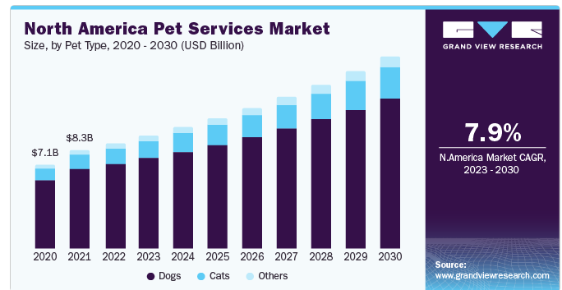
Market Opportunities

Slide 9
How We work
Door to Door Service
We will work as 3rd party supplier
Low cost Charge
Collect extra pet from the customer and sell

Slide 10
Thank You

